Slide 1
Romania Business Trip
Çerkezköy CHAMBER OF COMMERCE AND INDUSTRY
INTERNATIONAL RELATIONS DEPARTMENT
İLKNUR İNAL ER
Çerkezköy, Tekirdağ – 19/11/2019

Slide 2
SCOPE
1
Ambassador’s Visit
2
Economic Forum
3
Bilateral Business Meetings
4
Romanian Investment Association Visit
5
Prahova CCI Visit
6
Cooperation Agreement
7
Visit to Ploiesti Industrial Park
8
Thanks

Slide 3
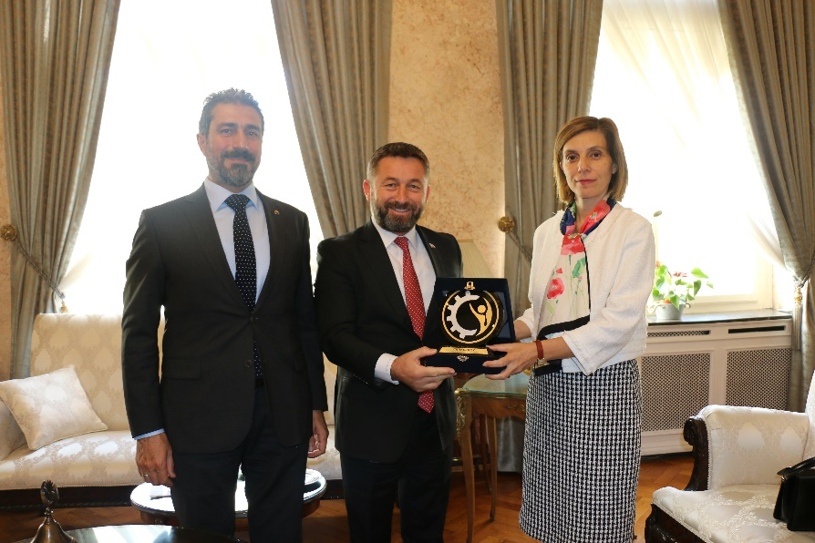
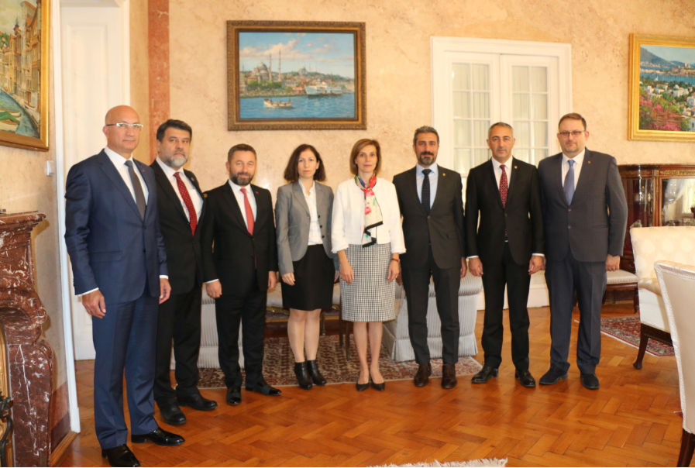
ROMANIA BUSINESS TRIP
T. C. Ambassador of Romania, Mr. Füsun Aramaz's visit
The Chairman of the Board of Directors Mr. Süleyman KOZUVA and the Assembly Mr. Hacı Mehmet ERDOĞAN and the Members of the Board of Directors; The Ambassador of Romania visited Mrs. Füsun ARAMAZ in her office and expressed our intention to increase our trade volume with Romania.
Negotiations, Mrs. Sude Gürcan, our Romanian Trade Consultant, also participated.

Slide 4
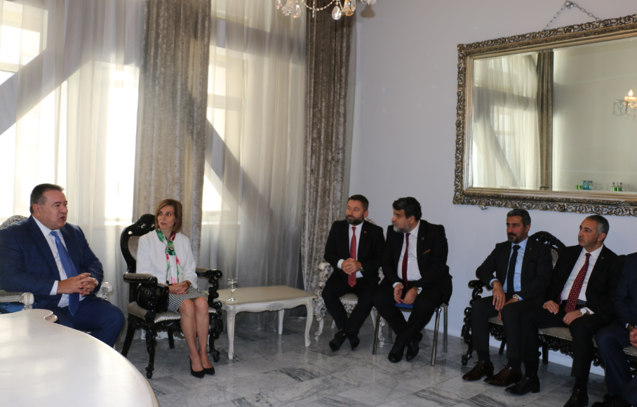
ROMANIA BUSINESS TRIP
Ekonomic Forum
Prior to the Economic Forum, Mr. Mihai Daraban, President of the Romanian Chamber of Commerce and Industry, hosted our Board of Directors in his office.

Slide 5
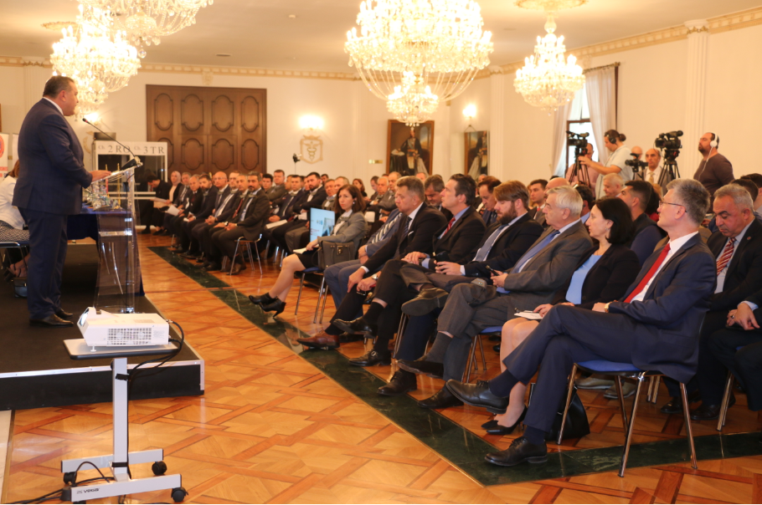
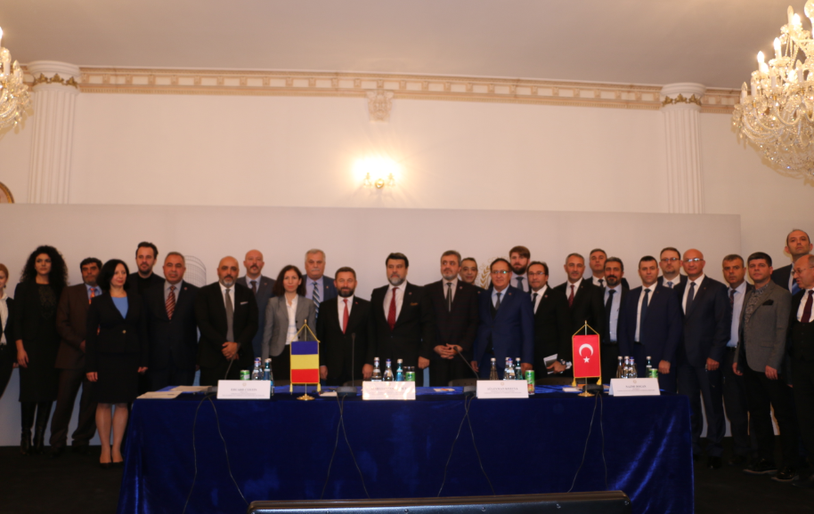
ROMANIA BUSINESS TRIP
Ekonomic Forum
In cooperation with the Çerkezköy Chamber of Commerce and Industry and the Romanian Chamber of Commerce and Industry, an economic forum was organized in Romania with the participation of Romanian and Turkish businessmen. At the Economic Forum, participants were informed about investment opportunities and export opportunities in Romania.

Slide 6
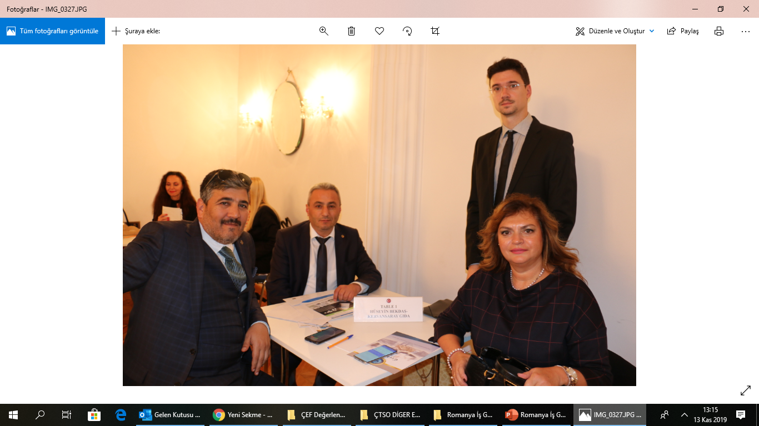
ROMANIA BUSINESS TRIP
Bilateral Business Meetings
Çerkezköy CCI member companies came together with Romanian companies within the scope of B2B meetings and made contacts with export and investment issues.

Slide 7
ROMANIA BUSINESS TRIP
Romanian Investment Association Visit
The Chamber Board of Directors visited the Turkish Investment Association of Romania and learned about the opportunities that Turkish companies investing in the region and the issues to be considered in the region.

Slide 8
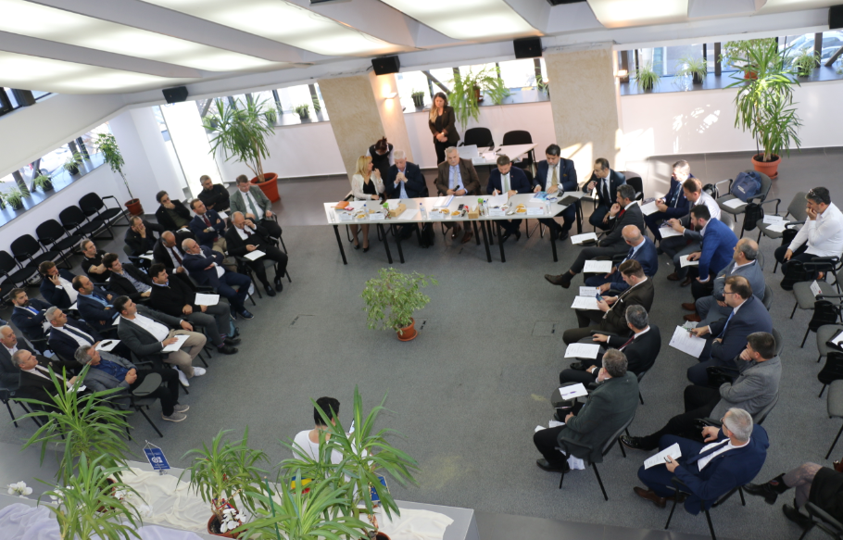
ROMANIA BUSINESS TRIP
Visit to Prahova Chamber of Commerce and Industry
The town of Prahova, developed in the industrial area in Ploiesti, Romania, has similar characteristics to Çerkezköy. Prahova CCI, which has approximately 6000 members, provides services in various subjects to the companies in the district. During the meeting, the services offered to the members of the two Chambers were shared.

Slide 9
ROMANIA BUSINESS TRIP
Prahova Chamber of Commerce and Industry Cooperation Agreement
After the meeting, Prahova Chamber of Commerce and Industry and Çerkezköy Chamber of Commerce and Industry signed a Cooperation and Agreement. The two chambers will support each other internationally and share every opportunity for their members.

Slide 10
ROMANIA BUSINESS TRIP
Visit to Ploiesti Industrial Park
Ploiesti Industrial Park is a special industrial zone with international and local companies. During the meeting held in the administrative building of the industrial park, our delegation had detailed information about the industrial park.

Slide 11
ROMANIA BUSINESS TRIP
Tessutica Romania S.R.L. Company Visit
Located in Ploiesti Industrial Park, Tessutica Romania S.R.L. Fabric production company was visited. The company, which has an integrated production facility, was visited by our committee.

Slide 12
ROMANIA BUSINESS TRIP
Modpack System S.R.L. Company Visit
Modpack System S.R.L. Company was visited by our committee and information was given about production processes and product characteristics.

Slide 13
ROMANIA BUSINESS TRIP
Business Connections
With our business trip to Romania, 8 members have established business contacts.

Slide 14
ROMANIA BUSINESS TRIP
Çerkezköy CCI Romania Business Trip Delegation

Slide 15
THANK YOU
Çerkezköy CHAMBER OF COMMERCE AND INDUSTRY
INTERNATIONAL RELATIONS DEPARTMENT
İLKNUR İNAL ER
Çerkezköy, Tekirdağ – NOVEMBER/2019

